Slide 1

Understanding your audience
&
Finding data
Week 2
Jan 17, 2016

Slide 2
Week 2 topics
Understanding your audience
Exercise: Department wants and needs
Finding data, internally and externally
Exercise: Download/visualize a public data set

Slide 3
First things first
Before data, before tools, before charts: Who will view and use your visualizations?

Slide 4
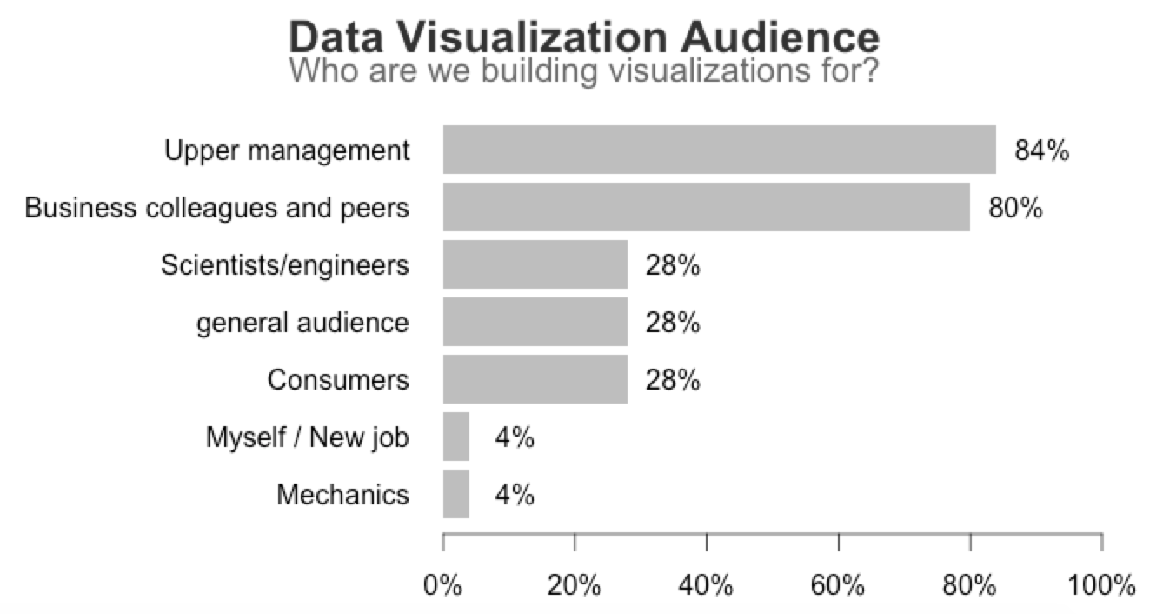
Results based on 25 respondents out of 32 total students.

Slide 5
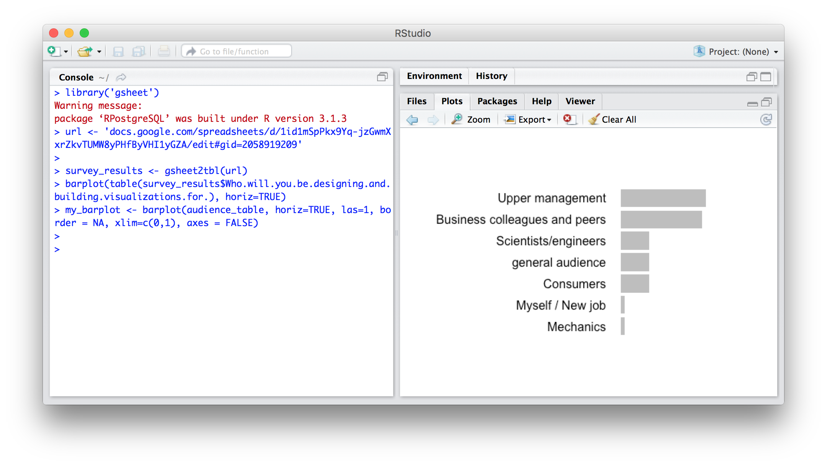
Using R to make a bar chart

Slide 6
A similar style, but…
Source: http://www.theonion.com/graphic/why-are-we-deferring-our-college-loans-38162

Slide 7
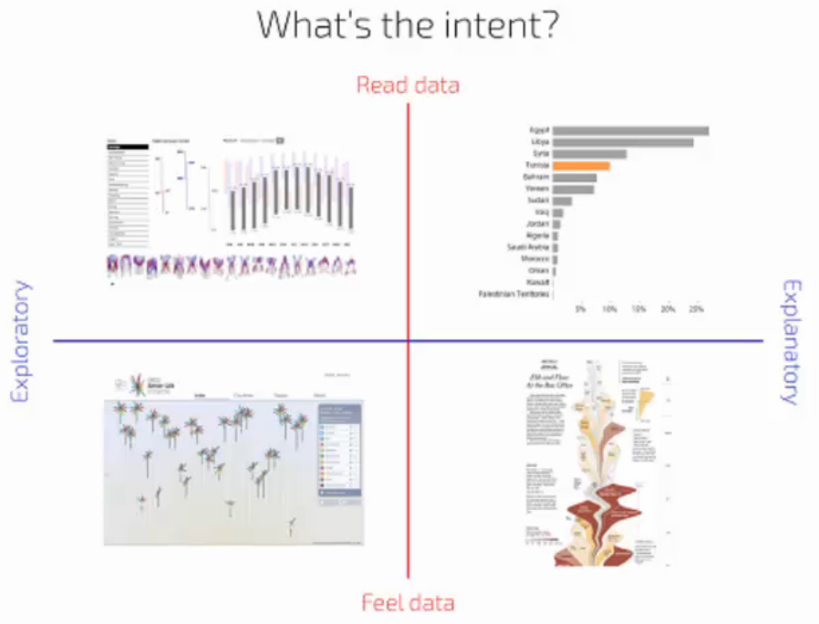
What will your audience do with the visualization?
Source: Andy Kirk, http://www.tableau.com/learn/webinars/art-and-science-data-visualisation

Slide 8
How to understand your audience
Conversations – This is how most visualizations start. Personal conversations, ideas, and requests.
Existing reports & visualizations – How are data visualizations currently presented?
Surveys – For larger groups
Interviews – Similar to surveys, but longer, more in-depth.

Slide 9
Who is your audience?
C-level – High level, broad company view, limited time
Analysts – Interactive and exploratory, repeatable
Mass audience – Simple, easy to understand, unique
Scientists, professionals – Technical, domain expertise
Peers/colleagues – What would you want to see?

Slide 10
Who is your audience?
Job Role | Level of Data
C-level | Company, high-level
VP & senior managers | Multi-division, high-level
Directors & managers | Team view, high-level, drill down
Individual contributors | Team view, drill down to details
Static
Summary
Interactive
Details
This is merely a guide
Company structures vary dramatically
Teams and individuals will also vary in their interest, abilities, and time

Slide 11
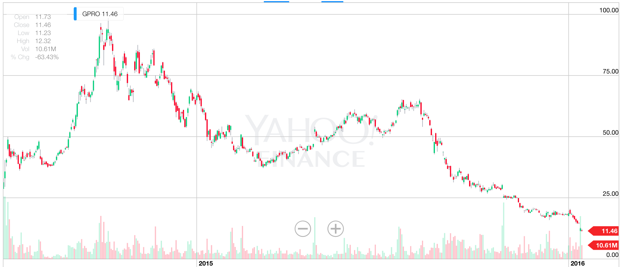
C-level audience (CEO, CFO, etc)
Keep your work simple and direct
Focus on KPIs, progression toward goals
Visualizations optimal for being saved as PDFs
Be prepared for more in some cases (Jeff Bezos [Amazon] six-pager comes to mind)

Slide 12
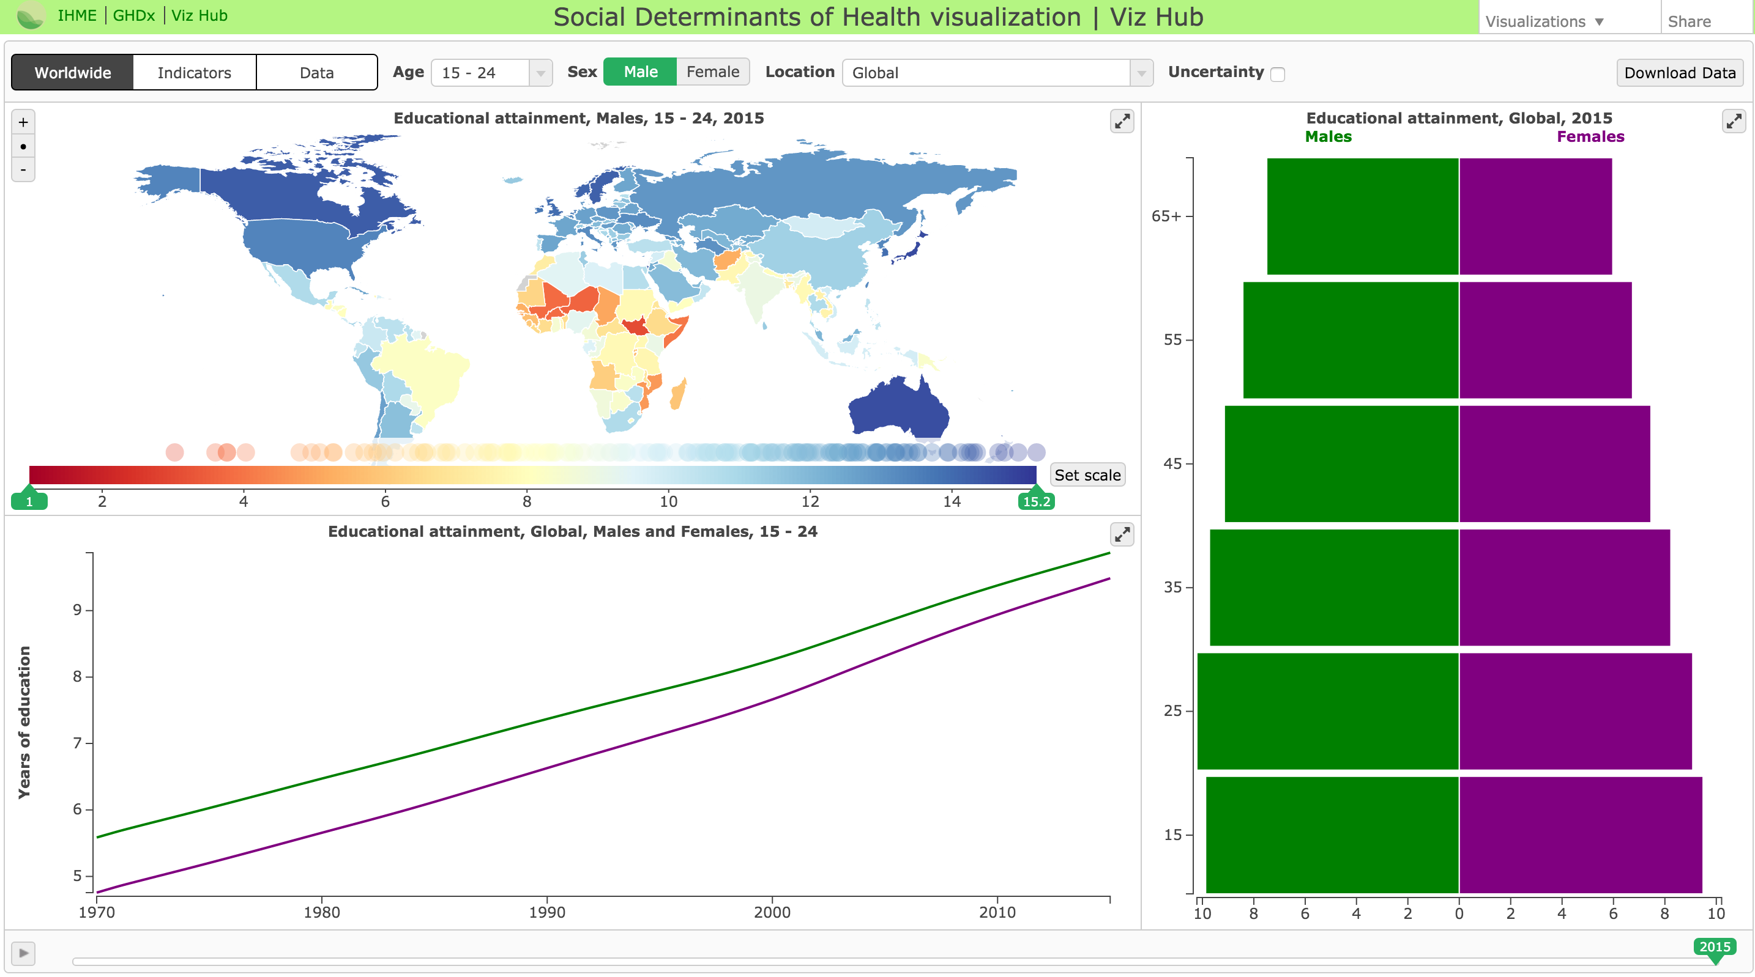
Analyst audience
Interactivity that enables ability to analyze and find stories in the data.
Filters, dashboards, and parameters help
Tool choice can be important
Make the work repeatable
IHME health viz

Slide 13
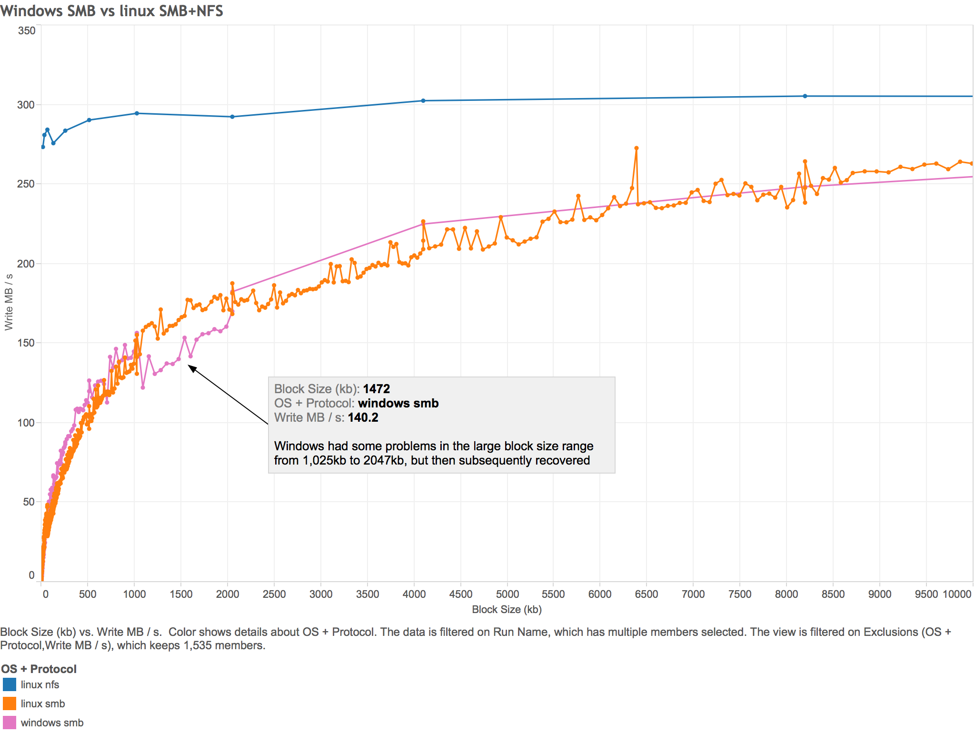
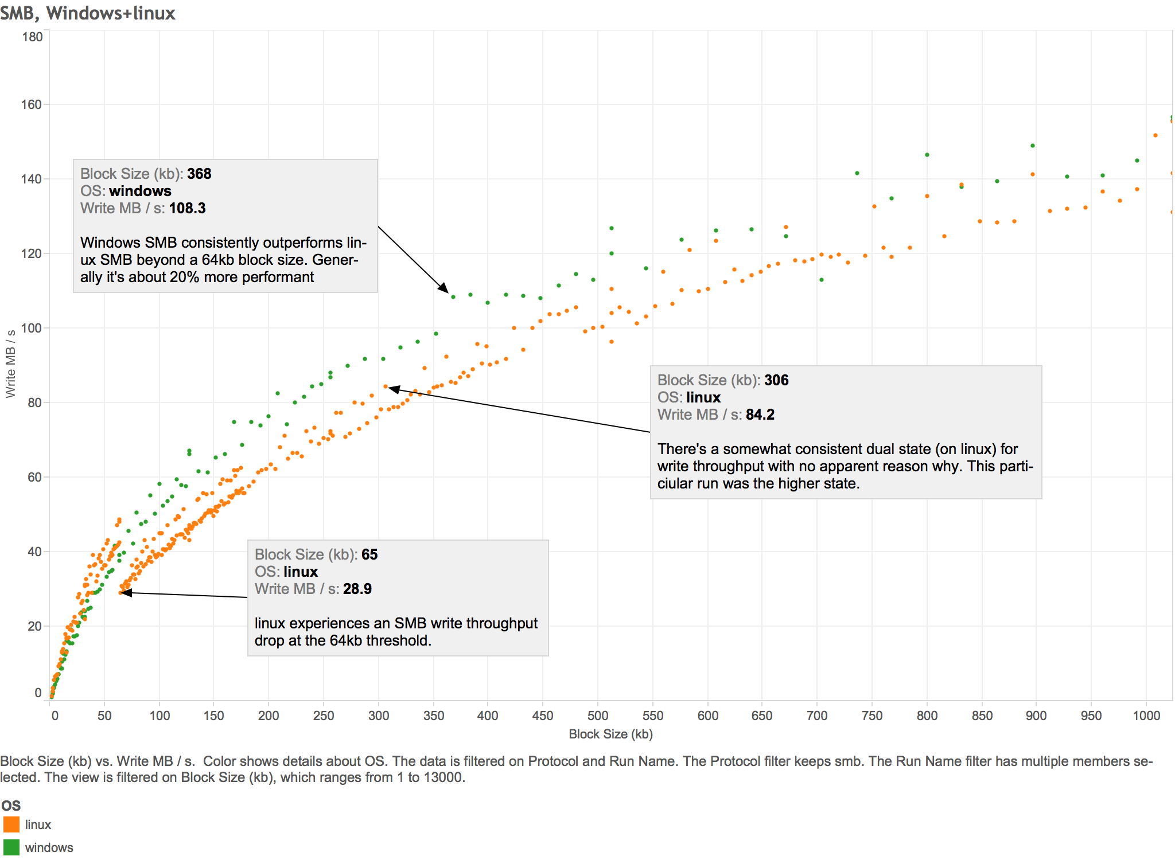
Scientists and specialists
Must have domain knowledge
Can be data heavy
Explore many scenarios

Slide 14
Why do Qumulo customers visualize?
Data scales infinitely, but human perception and comprehension does not.
System is complex, but need to convey data and information simply.
Help customers grow their data and their understanding of it.
Save time, minimize frustration, maximize actionability.

Slide 15
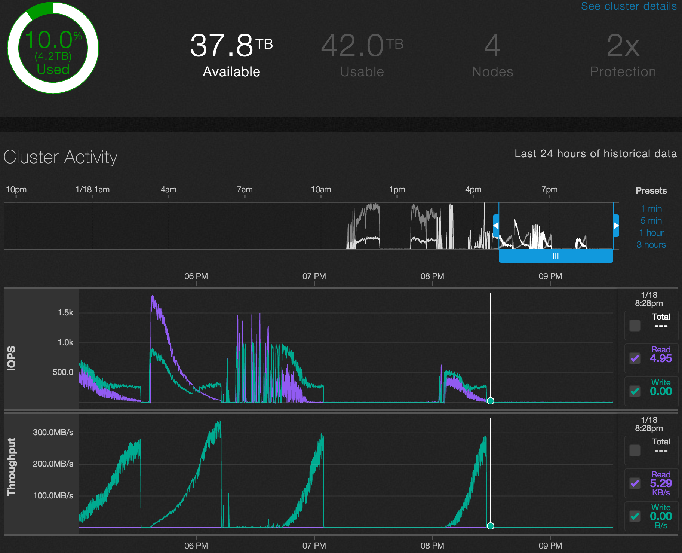
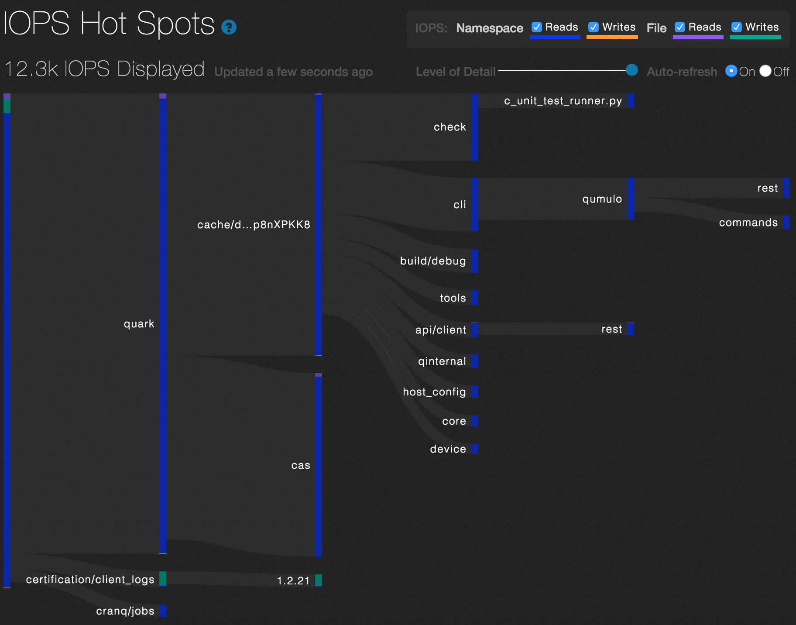
Qumulo’s visualizations

Slide 16
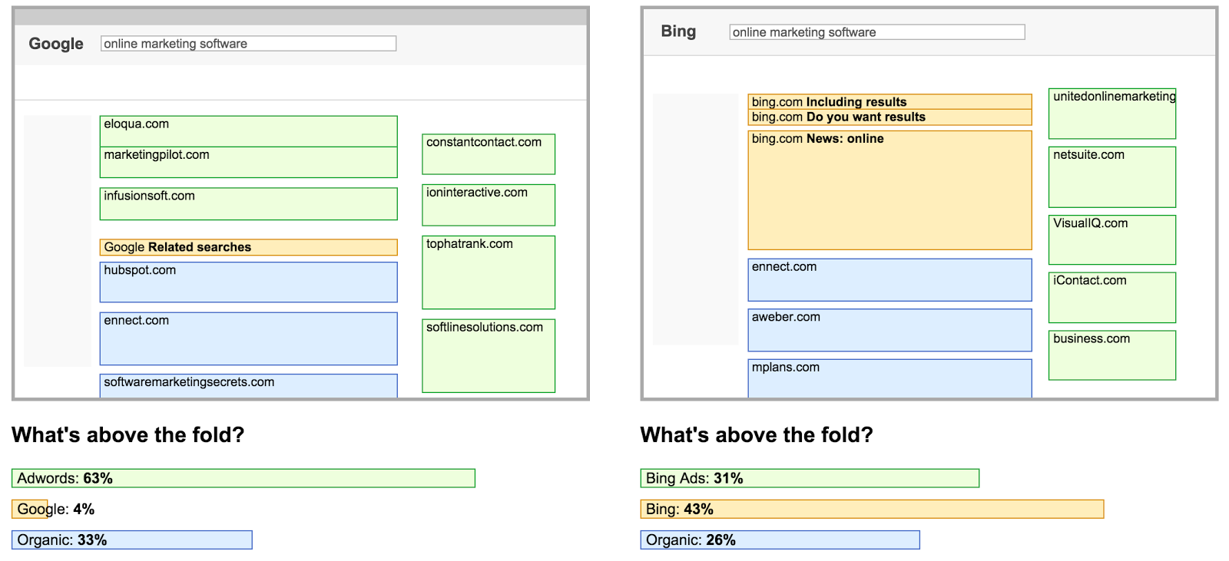
Specialists: SEO
Do I need to pay for people to see my company in the top two search engines?

Slide 17
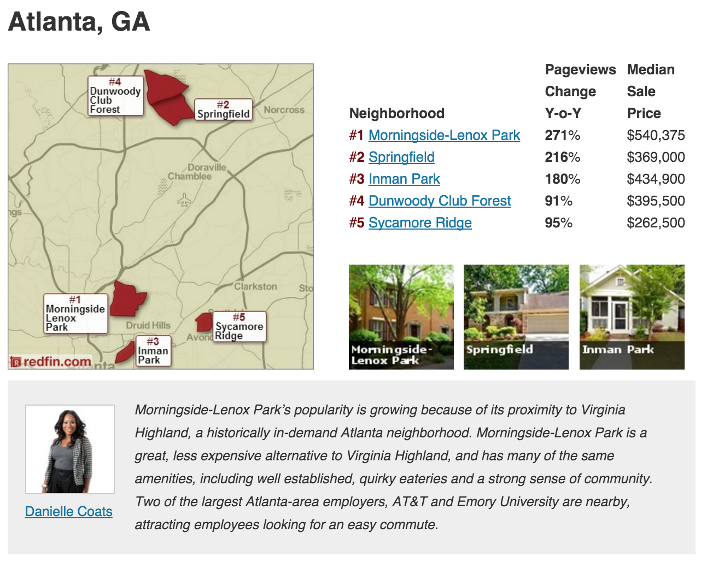
Mass audience
Make the takeaway clear
Content should be relevant to its medium
Think about sharability
Redfin

Slide 18
You understand your audience... does your audience understand you?
Can you explain your visualization to your audience in one sentence?
Anticipate questions about your visualization, both obvious and hard-to-answer. Don’t worry, questions indicate engagement.
Titles, blurbs, and highlights can help illuminate.
Measure results – pageviews, shares, etc

Slide 19
Exercise: Who is your audience?
Departments
Customer Service
Engineering
Finance
Human resources
Information Technology
Manufacturing
Marketing
Operations
Sales
Pick a department.
What data would they expect to see?
How would they expect to see it? How would you visualize it?
How detailed should it be?
https://docs.google.com/spreadsheets/d/1lXO--wlCySJy0mBcPT8DhWKDfAbzUdppu8qIT-43SPE/edit#gid=0

Slide 20
Finding data

Slide 21
Finding data for visualization
Internal Company Data
Databases
Relational
NoSQL
Spreadsheets
APIs
Salesforce
Bug tracking
Internal systems
Text files/documents
Third party providers
Public, external Data
Search engine
Public/govt websites
APIs
Data downloads
Web scraping
FOIA

Slide 22
Internal company data
Be careful with sensitive data
Figure out what’s available
Explore the “schema”
Stay organized

Slide 23
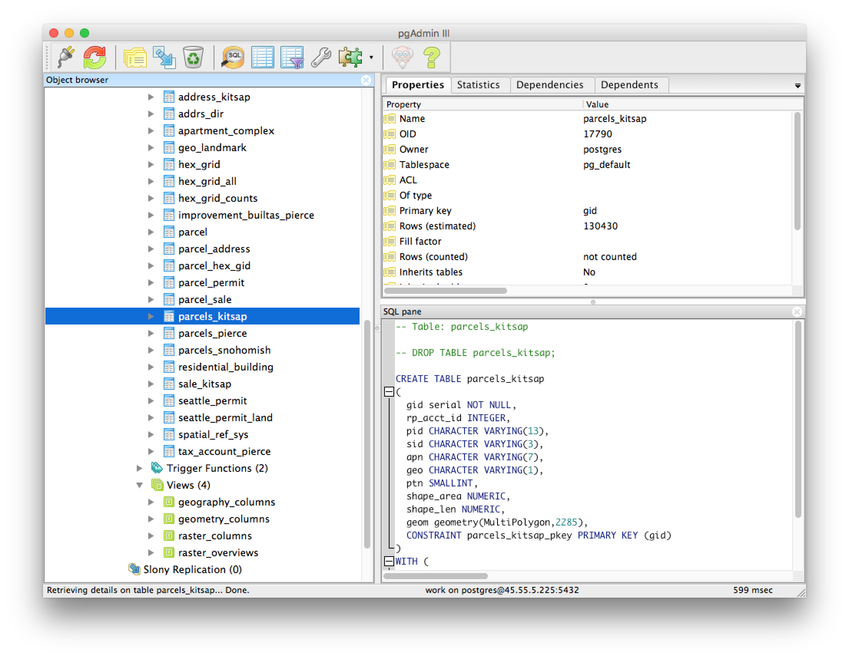
Have the proper tools
Usually there are GUI tools that make new data a bit more accessible.

Slide 24
Public data

Slide 25
A few personal favorites
Google: autocomplete, trends, ngrams
US Census
Facebook
FRED (Federal Reserve Econ Data)
Local websites

Slide 26
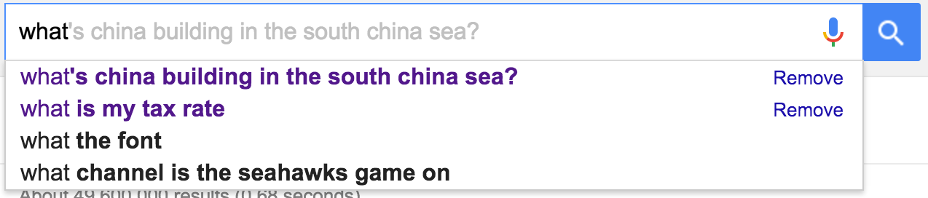
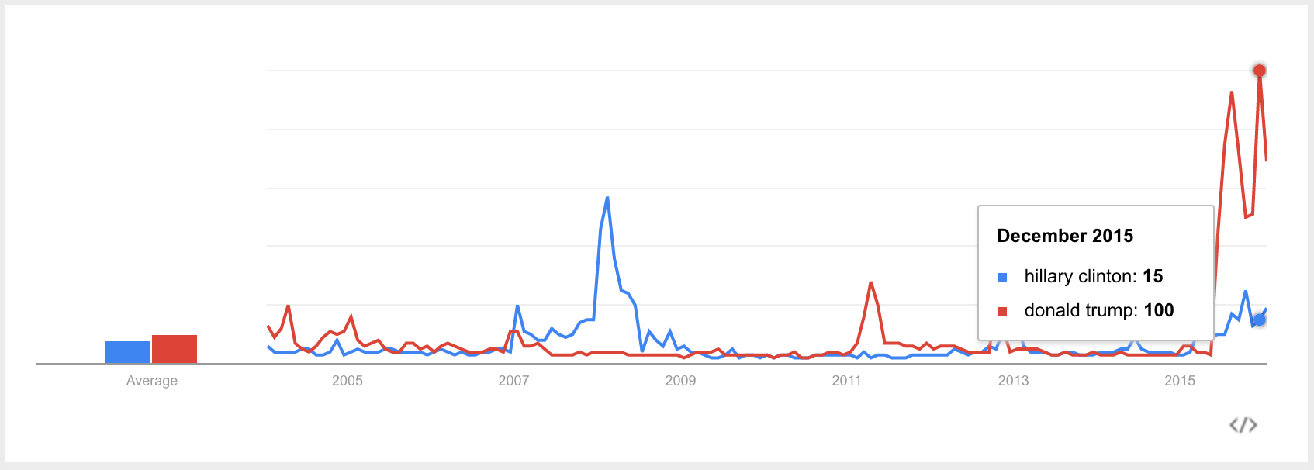
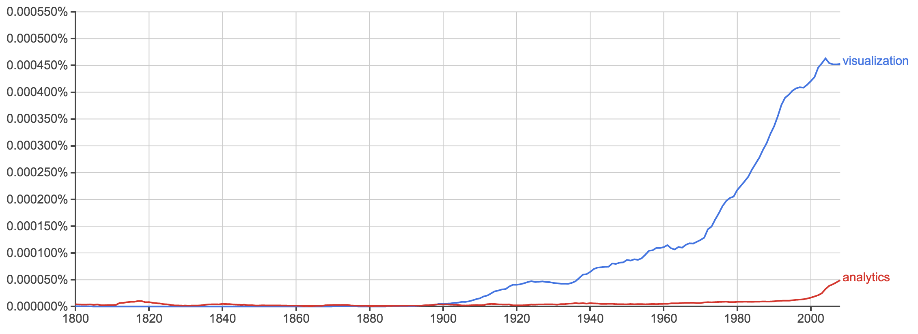
Google: autocomplete, trends, ngrams
Great for current and older trends
https://www.google.com/trends/explore
https://books.google.com/ngrams

Slide 27
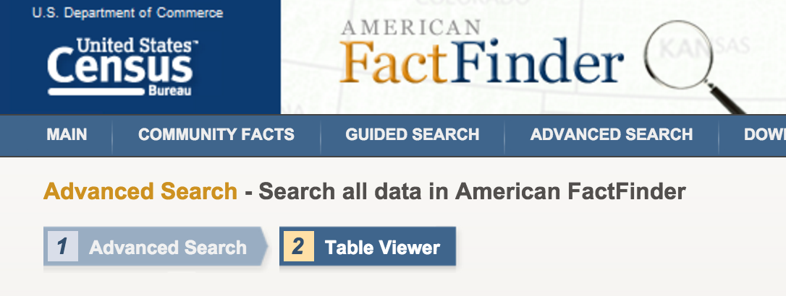
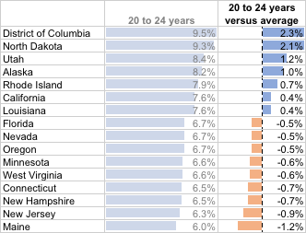
US Census
National, regional, to very local data about demographics and much, much more. Varies from easy to very hard to work with.
ACS DEMOGRAPHIC AND HOUSING ESTIMATES
2010-2014 American Community Survey 5-Year Estimates
http://factfinder.census.gov/faces/tableservices/jsf/pages/productview.xhtml?pid=ACS_14_5YR_DP05&src=pt
http://factfinder.census.gov/

Slide 28
Facebook: likes, shares, comments
How popular is something on the web?
How’d to get it?
https://api.facebook.com/method/fql.query?query=select url,comment_count,share_count,like_count from link_stat where url in('www.pce.uw.edu/')&format=json

Slide 29
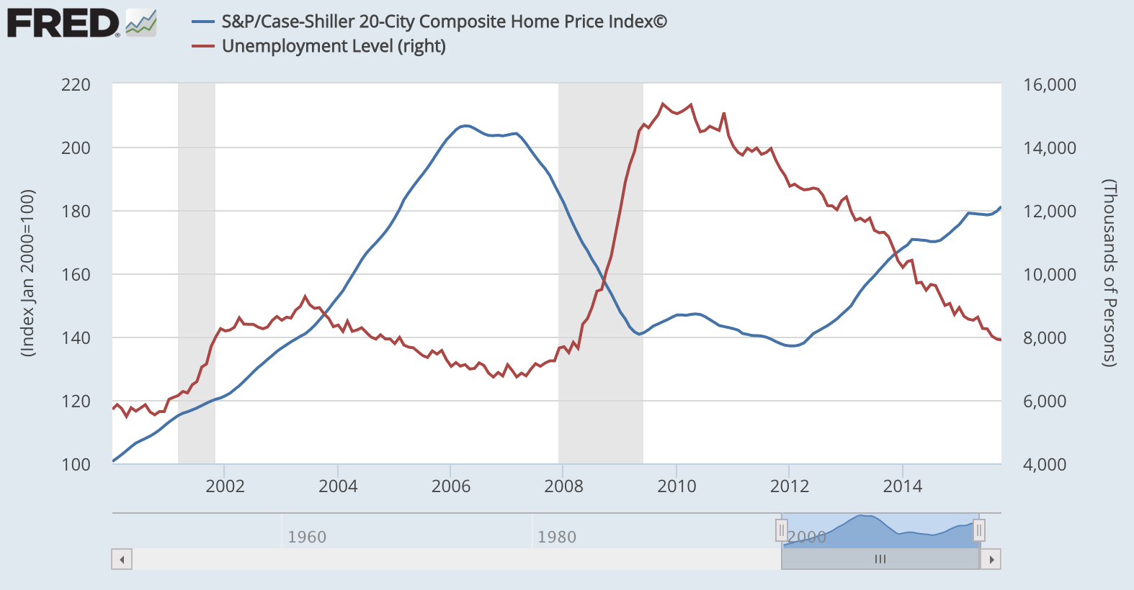
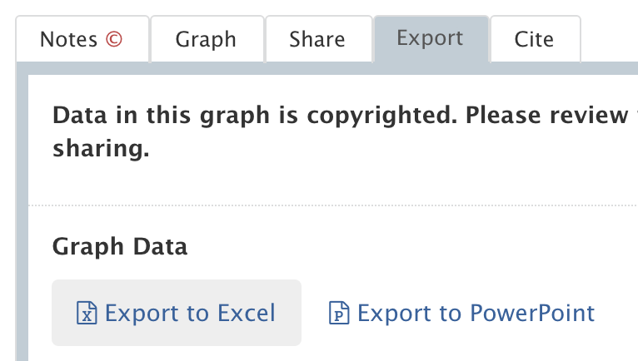
FRED (Federal Reserve Econ Data)
Economic data, over time
https://research.stlouisfed.org/fred2/

Slide 30
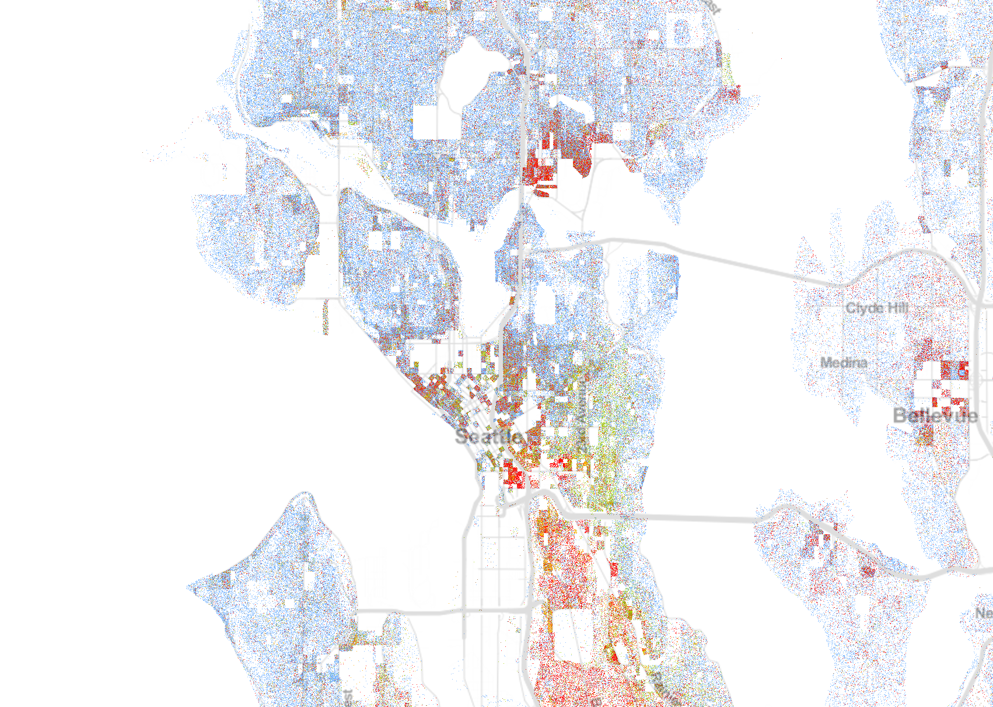
Dealing with data: Racial Dot Map
http://demographics.coopercenter.org/DotMap/index.html

Slide 31
Public data issues
Can be time consuming, difficult to get
What you see is what you get
Sometimes free sources are limited
Privacy implications - AOL search data leak
Some data, like web scraping, may break terms of service

Slide 32
Exercise/Homework: Visualize a public data source
Using two of the previously mentioned public data sources, create two visualizations that show which is the better place to live: Seattle, WA or Portland, OR
Visualizations don’t need to be complex or comprehensive. The goal is just to create a little support for which city is the best place to live. Use any visualization tool you’d like. Make it simple and convincing.

